Slide 1
Instructor Review Meeting 3
Team sddec24-16
Advisor: Dr. Maruf Ahamed
Cameron Jones, Blake Hardy, Cayden Kelly, Chase O'Connell, Holden Brown, Tejal Devshetwar

Slide 2
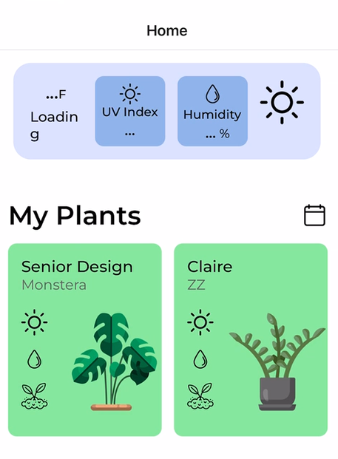
Introduction
Create a device that allows for users to monitor plant conditions on a mobile app
Made for hobbyist gardeners
Alleviates need for accumulated knowledge
Automates and simplifies timely soil tests
Allows amateurs to have a scientific understanding they normally wouldn't have
Notes:
-Flip narrative, this is what our device does and this is why it’s important.
-Can make the image larger or potentially add a picture of the physical device as well

Slide 3
Requirements
Physical Requirements
Reasonably sit next to pot sizes of 3+ inch diameter
Electronics enclosure on top of liquid reservoirs
UI Requirements
App displays sensor readings in various different ways (numerically, graphically)
User accounts with persistent data
Emergency notifications based on plant health
UX Requirements
The plant system should be low maintenance
The water reservoir should be large enough to hold multiple days worth of water
The mobile app should function reliably and predictably
Notes:
-Could be more specific
-List specific ways it should display data (graphically numerically)
-Specify number of days for water or specific amount in liters
-More specific on being low maintenance, sub-bullets, specific tasks related to being low maintenance
-Nitificatioons good

Slide 4
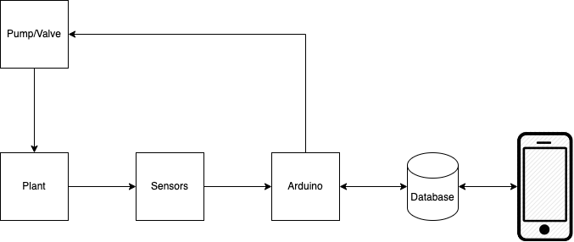
Design Overview
Notes:
-Good and clean
-IRP: Go into more specific detail on separate slides after high level
-Actual image of the plant may be good
-Include the specific sensors in the diagram at this level
-Go from high level to really high level
-Will get questions about testing, how you know it works, overall design

Slide 5
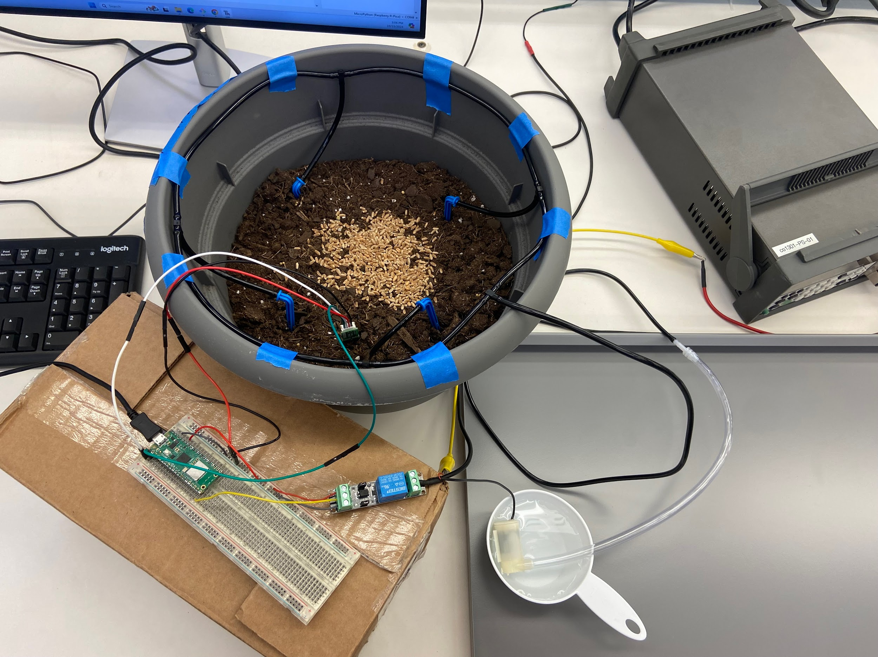
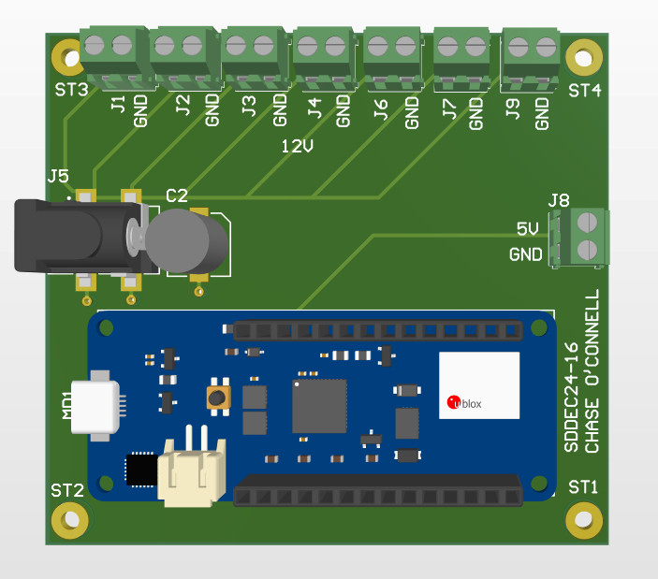
Progress/Outcomes

Slide 6
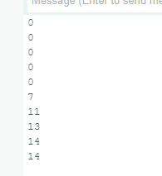
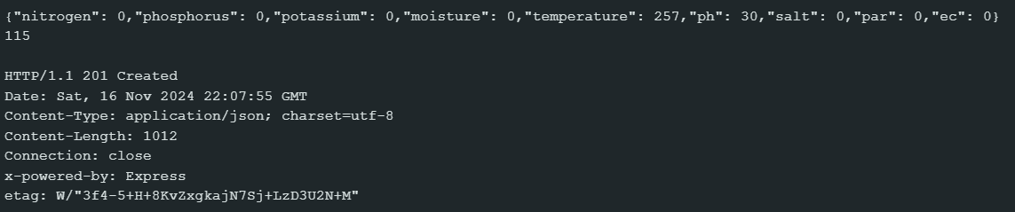
Progress/Outcomes
Data Transmission to Server: All 3 Sensors
PAR Sensor Output:
Notes:
-Could be larger to see more easily
-If showing in IRP, explain specifically what they are seeing, what the values mean, etc.
-

Slide 7
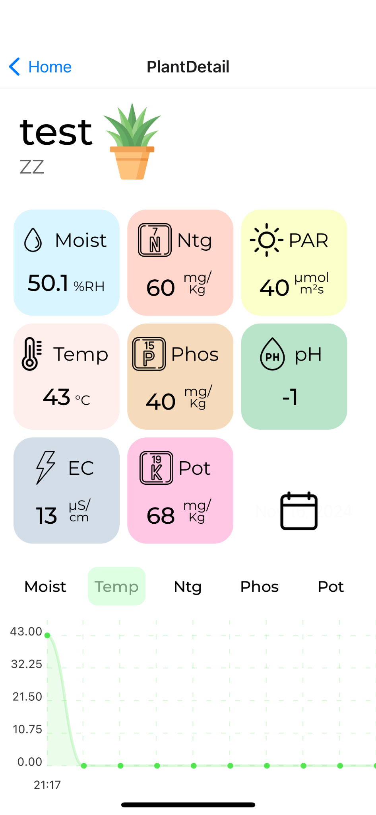
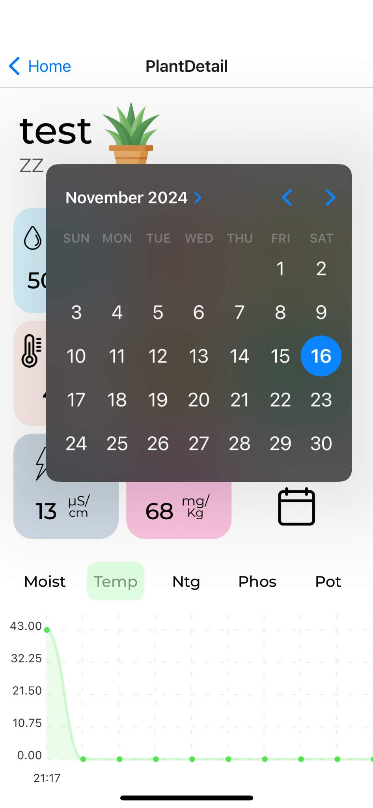
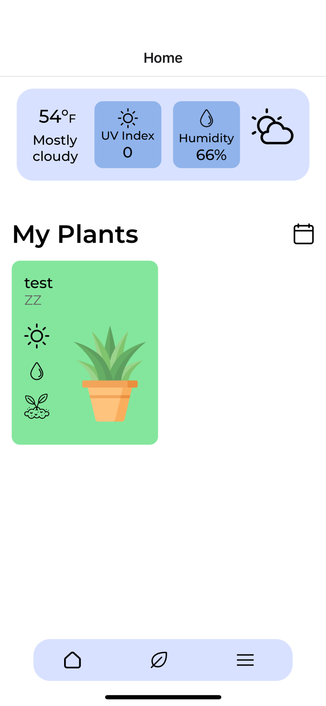
Progress/Outcomes
Notes:
-Explain what you have and why you made specific decisions
-Potentially separate out into different slides and talk more in depth on each screenshot
-”Tell the story” of sensor selection and options. Why we chose what we did.
-Could do a live or recorded demo showing app values changing
-Generally recording is recommended

Slide 8
Pending Issues/Concerns
Device may be unable to detect erroneous states and react properly
Implement something to discard bad data
Alert user to error state and prompt them to correct
Explore additional firmware features
Low power modes
Real time capabilities
Investigate effective update rate to minimize power consumption with sufficient data
Physical protection
Maintain water resistance + minimize enclosure openings
Securely mount external components and the enclosure itself
Need to determine data viability, variability, and sensor calibration
Notes:
-Talk more in depth about testing procedure, verification it works

Slide 9
Questions?
Notes:
-Can put documentation on website to guide IRP members for more detailed info.
-Based on quality of presentation as well as what you’re presenting.
-3 people, averages 25%

